Slide 1
Historical Traffic Crash Data in Relation to the Adoption of Mobile Phones

Slide 2
Questions
How has the adoption of mobile and smart phones into everyday life affected the incidence of traffic accidents in nationally?
How has the adoption of mobile and smart phones into everyday life affected the incidence of traffic accidents in specific states?
Does age play a factor in distracted driving accidents?
How has the adoption of mobile applications into everyday life affected the incidence of traffic accidents in these states?

Slide 3
Hypothesis:
U.S. automobile non-fatal and fatal accidents have increased with the adoption of cell phones.
The adoption of smartphones will also increase the amount of non-fatal and fatal accidents.
The popularity and adoption of mobile apps will increase the amount of non-fatal and fatal accidents.
There will be a noticeable difference in the amount of crashes based on age. Specifically, younger people will have a higher amount of crashes

Slide 4
Data Sources:
Accident data
FARS and NHTSA (https://www.nhtsa.gov/)
CSV downloads (Excel) and API (Pandas)
Registered Drivers by State
CSV download (Pandas)
Google Public Data
Mobile Adoption Data
Mobile App adoption, Mobile phone and smartphone adoption,
Pew Research, Statisa
National Smartphone Adoption
Statisa

Slide 5
Data Exploration, and Cleanup
We utilized several methods to clean the data: transposing, formatting the type elements, renaming columns, indexing and re-indexing, dropping null values

Slide 6


API: FARS (Fatal Accident Reporting System)
With regards to state level accident data, we were unable to pull data for all 50 states. This would be impossible as we hit a record cap at 5000 records. We resolved this by focusing on 8 states.
Clean-up was minimal. Once we figured out which columns we wanted to pull, we pulled them from the API

Slide 7
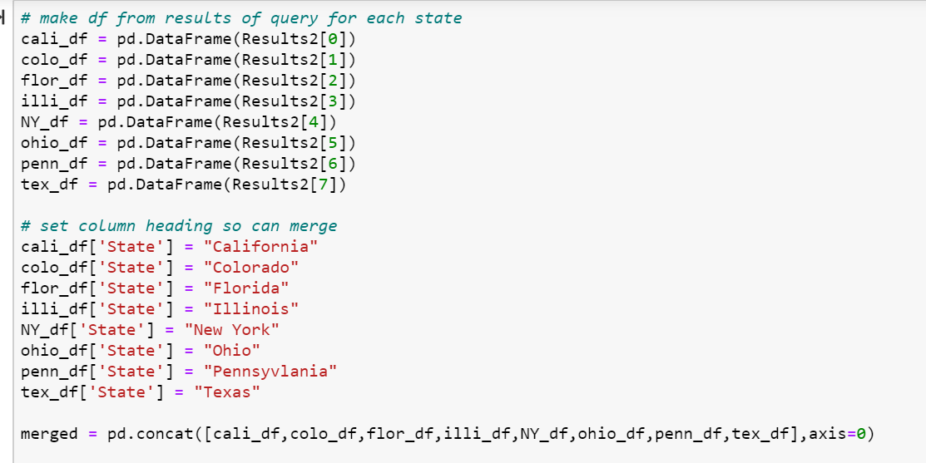
API: FARS (continued
Built dataframe for results for each state and merged into one larger dataframe.

Slide 8
CSV from NHTSA (National Highway Transportation and Safety Administration)
For aggregated national data, we used to website to download CSV files
Clean-up on these files were minimal including renaming columns, merging data, dropping null data, converting strings to floats.
[insert martin’s screenshots?]

Slide 9
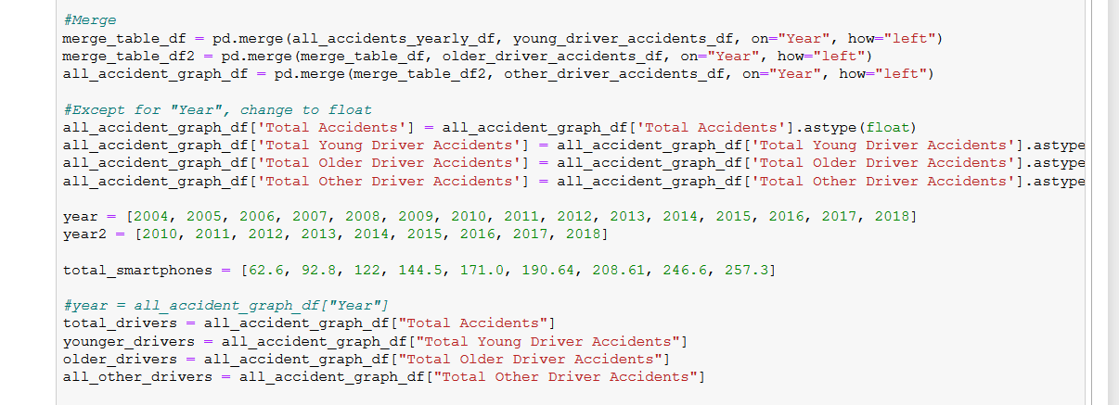
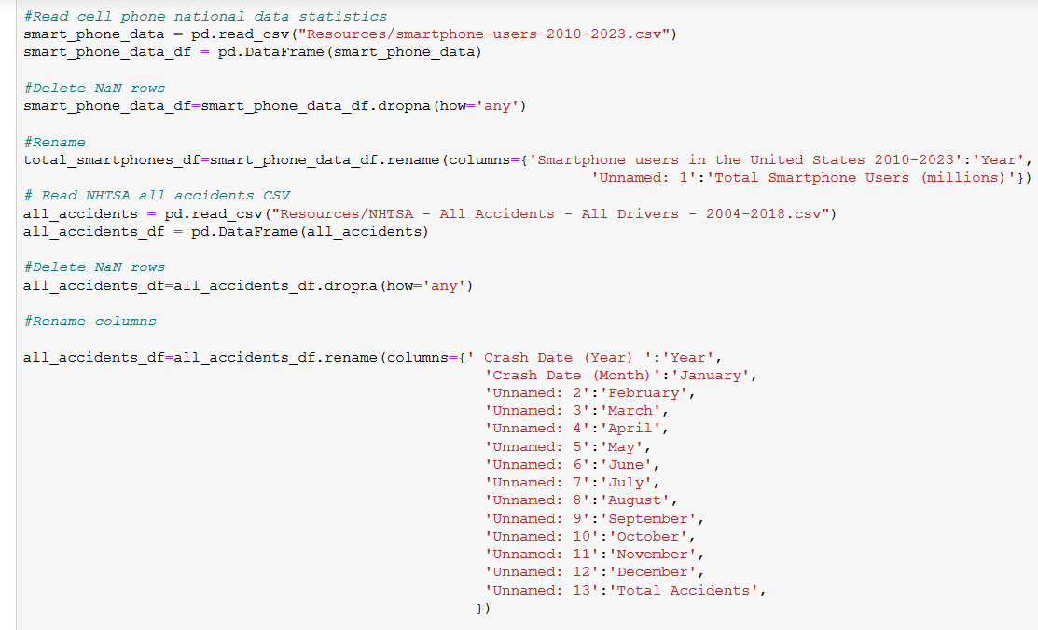

Slide 10
Data Visualization
National Data
Total
By Age
State Data
Total
Vs Mobile Apps

Slide 11
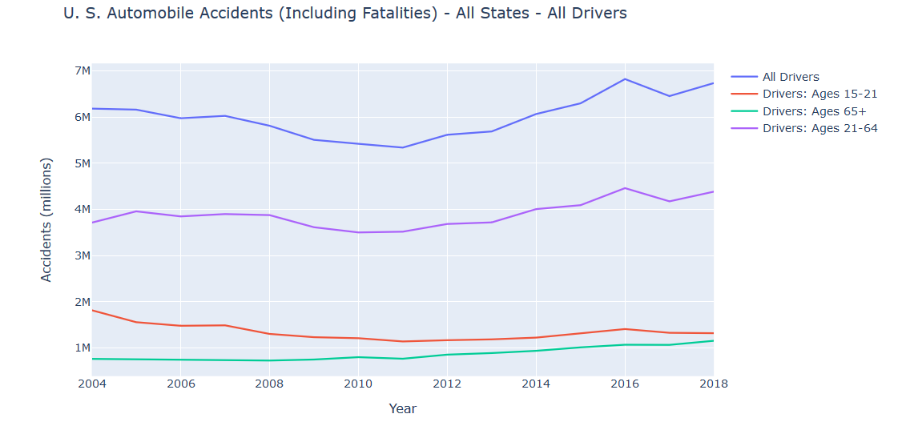
National Data:

Slide 12
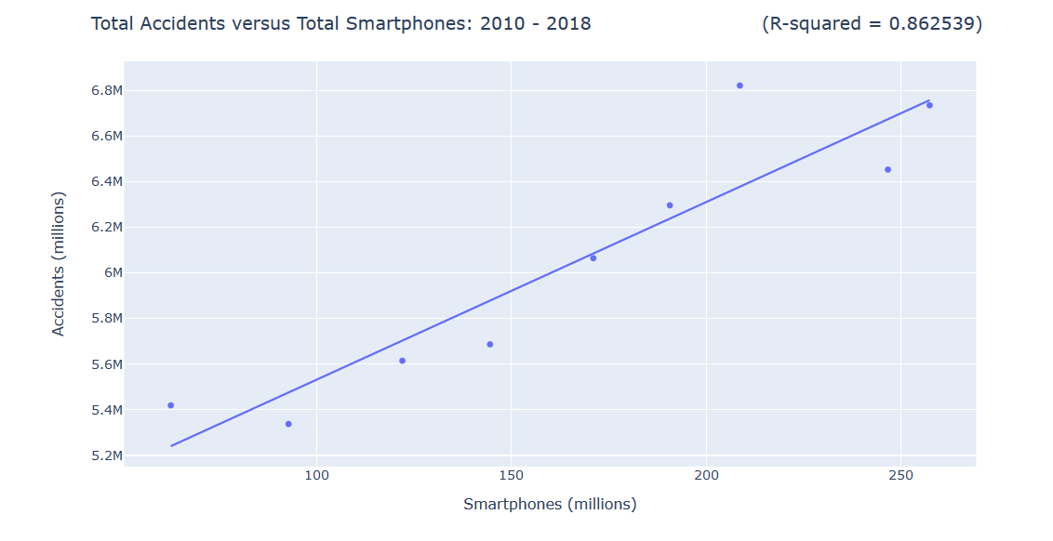

Slide 13
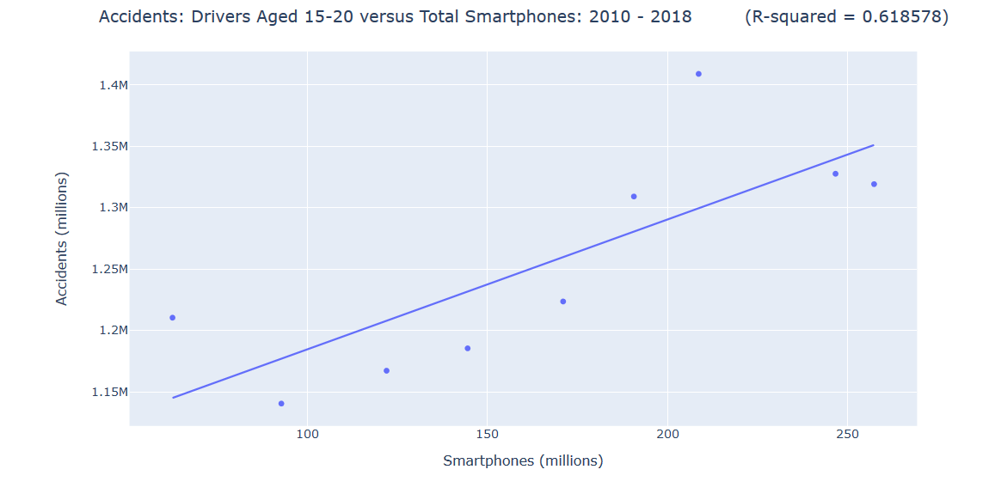

Slide 14
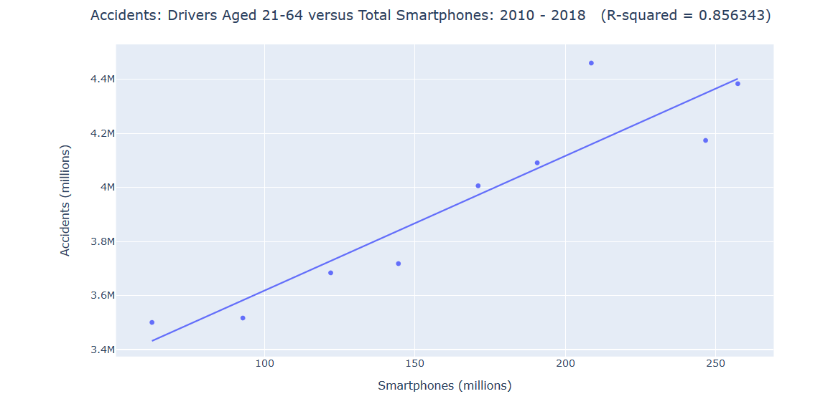

Slide 15
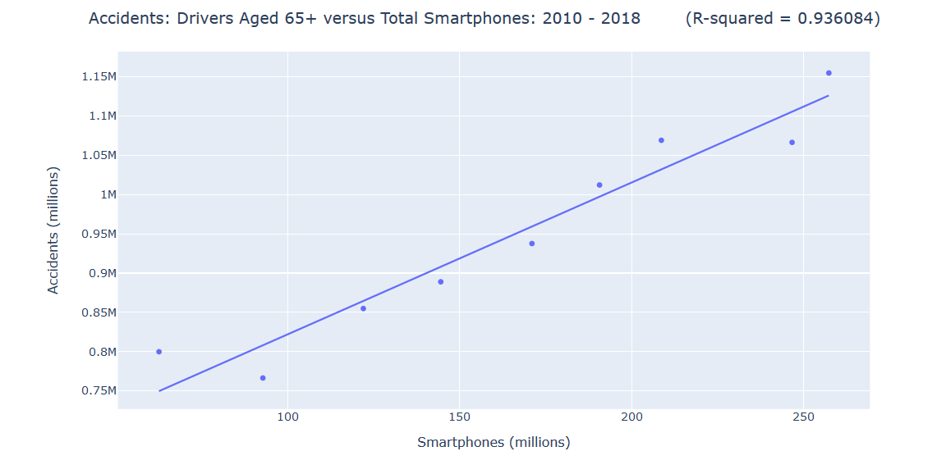

Slide 16
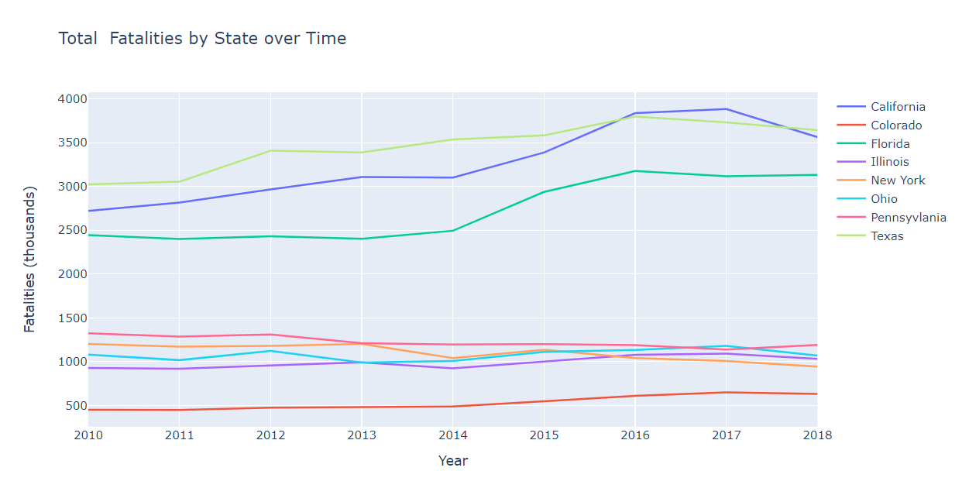
State Data:

Slide 17
State Data and conclusions:
A regression of fatal crashes in 8 states versus the number of smartphone users resulted in an R-squared value of 0.900 and a p-value of 0.0009.
A regression of fatal crashed in 8 states versus the number of monthly active users of mobile apps resulted in an R-squared 0.929 and a p-value of 0.0003.
These values would suggest that there is indeed a relationship between fatal crashes and mobile phone users as well as fatal crashes and MAUs of mobile apps.
However, because this data only contains 10 data points (years) the results are not very reliable.

Slide 18
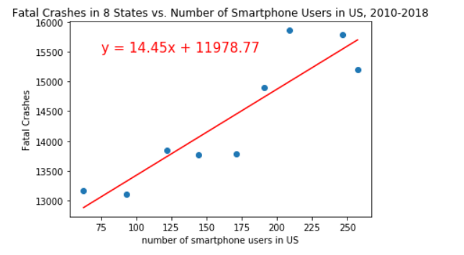
R-squared is: 0.9003186964685078
p-value is: 0.0009328845788830946

Slide 19
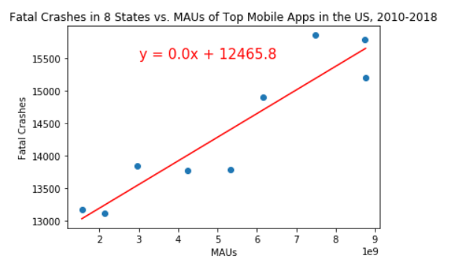
R-squared is: 0.9287022633277064
p-value is: 0.00029703475180740437

Slide 20
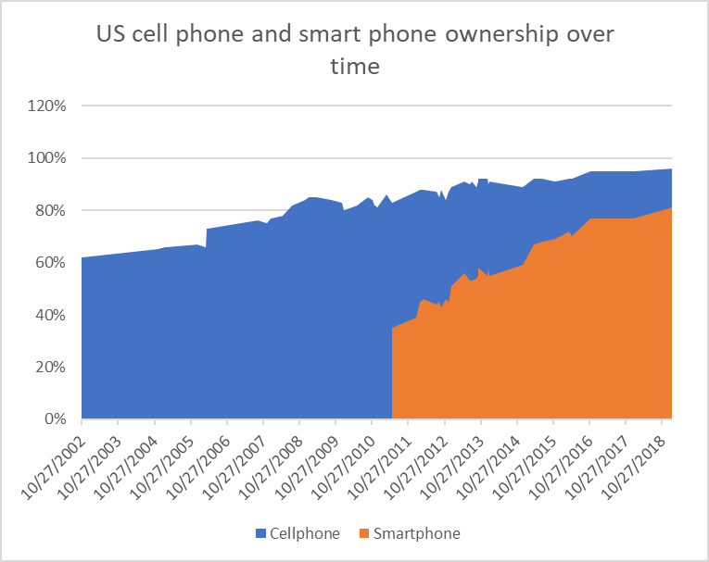

Slide 21
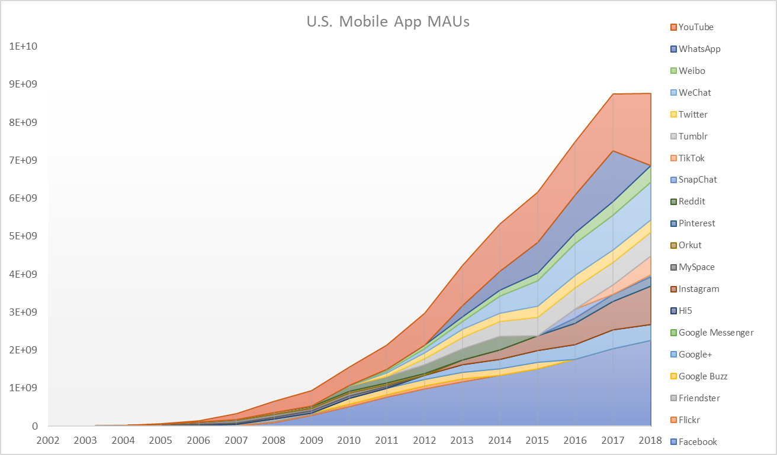

Slide 22
Acknowledgment of Limitations
API
Limitation of 5000 records. Pulling national data was maybe 3 states at a time due to the record cap.
Cell Phone / Smartphone ownership data and Mobile MAU data
Data available for free was limited to aggregated US totals by year.
Data from more frequent timepoints would improve results

Slide 23
Summary
How has the adoption of mobile and smart phones into everyday life affected the incidence of traffic accidents in nationally?
On a national level, our regressions indicated that increased smartphone usage correlated to an increase in accidents.
On a national level, our regressions indicated that increased mobile phone ownership did not increase fatal accidents.
How has the adoption of mobile and smart phones into everyday life affected the incidence of traffic accidents in specific states?
In the 8 most populous states, our regressions indicated that increased smartphone usage correlated to an increase in fatal accidents.
In the 8 most populous states, our regressions indicated that increased MAUs of mobile apps is correlated with an increasein fatal accidents.
Does age play a factor in distracted driving accidents?
Our regressions indicated that age does not play a significant factor accident frequency.

